Slide 1
“All creative activity begins with movement.” ~Joseph Zinker

Slide 2
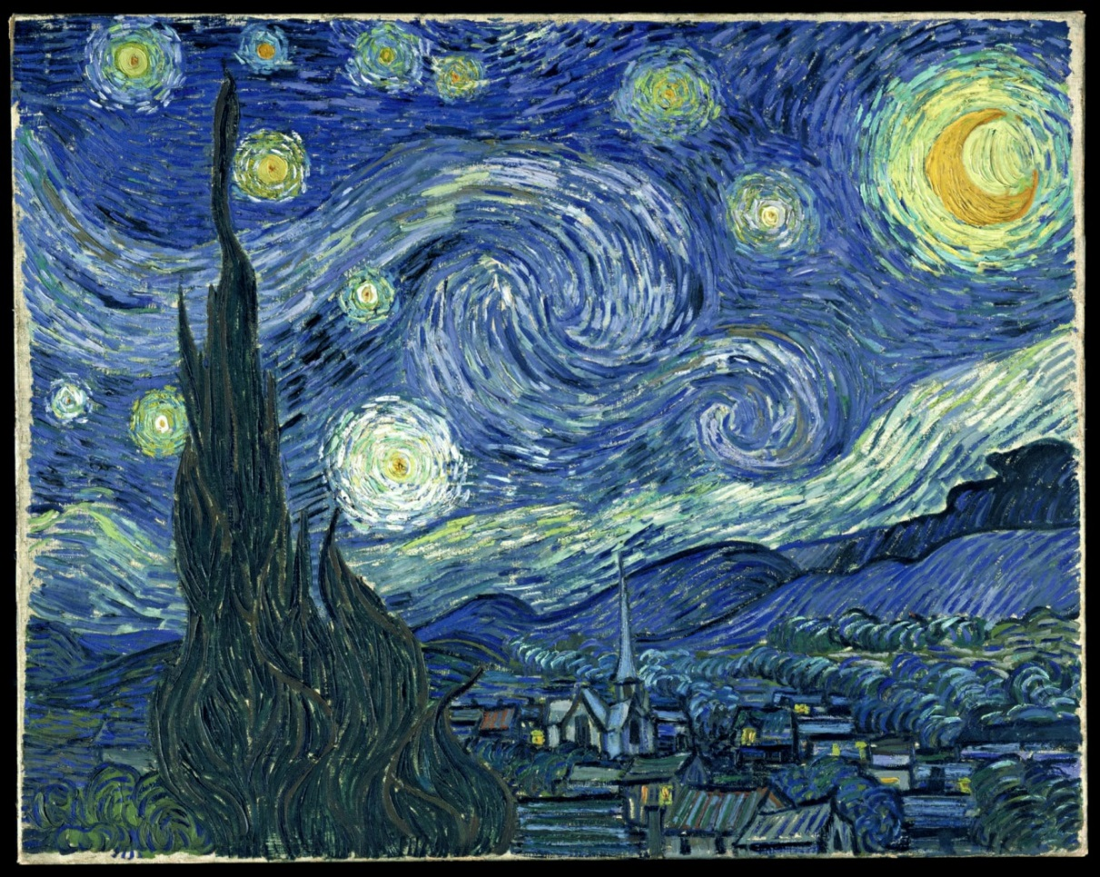
Principles of Design-Part 1
Pattern
Rhythm
& Movement
Starry Night by Vincent Van Gogh

Slide 3
Objective:
Identify and examine the principles of design: pattern, rhythm and movement.

Slide 4
Principles of Design are guidelines to help artists create artworks.
The principles describe the ways that artists use the elements of art in a work of art.

Slide 5
Critical Thinking:
We see pattern, rhythm and movement
in our everyday life.
Write down some things you see everyday that have pattern, rhythm
or movement.
Explain why it is important to have pattern, rhythm or movement for those things you listed.

Slide 6
The principles of design are a natural part of perception.
Most of us are not conscious of them in our everyday life,
but artist are usually very aware of them,
because they have trained themselves to be aware.

Slide 7
Pattern
KEY POINTS:
A Pattern is a Repetition of Units
The Unit that repeats is called a MOTIF.
A Motif is what makes a Pattern.
Stewie’s head is the MOTIF
In this pattern

Slide 8
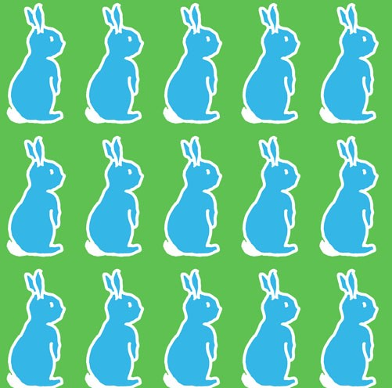
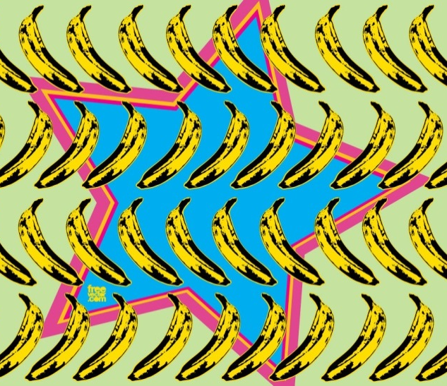
Identify the Motif in these images.
Why are they a pattern?
#1
#2
#3

Slide 9
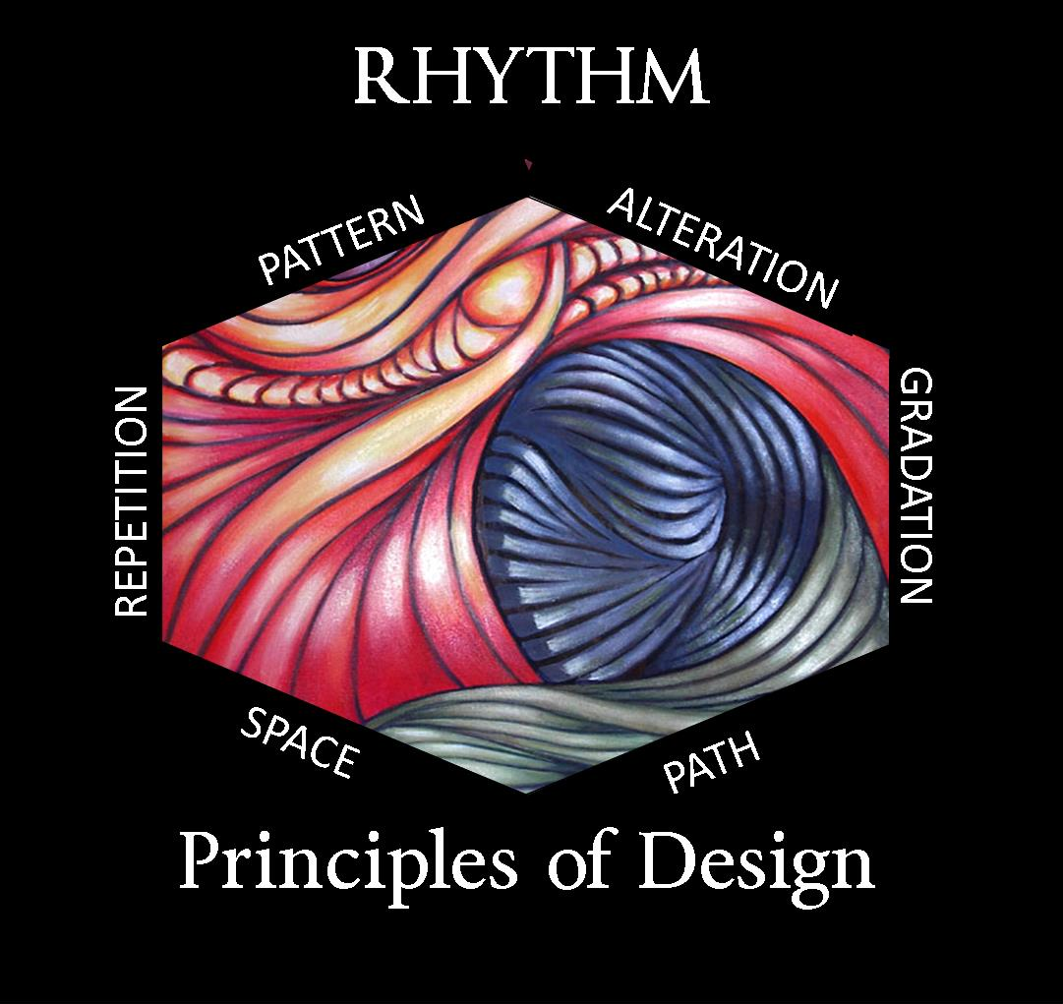
Not only does the visual arts represent rhythm, but some more common rhythm would be known in dance, music, and poetry.
All of these need rhythm in order to have a sense of flow and pattern.

Slide 10
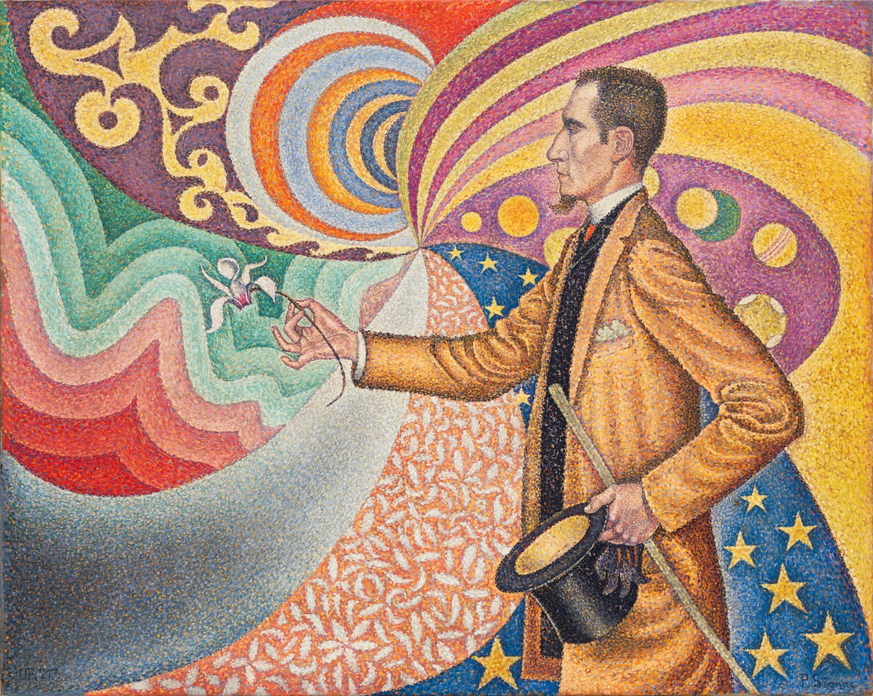
Rhythm
A pattern that shows movement.
Portrait of Félix Fénéon oil on canvas. Created by Paul Signac, 1890, located in the Museum of Modern Art, New York. Pointillism,
Neo-Impressionism.
Regular repetition of lines, shapes, or color
that creates a pattern to the overall design.
Notes:
(I DO)Concept Development: Underline; Rhythm shows movement and repetition of lines shapes or color that creates a pattern. ←----Key vocab to understanding Rhythm.

Slide 11
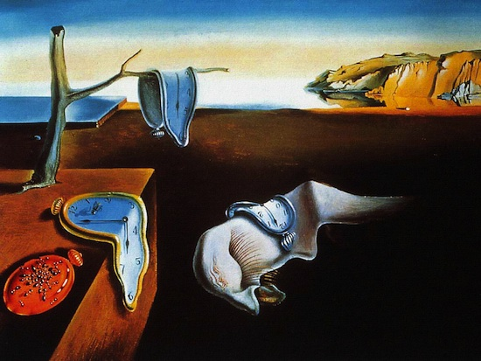
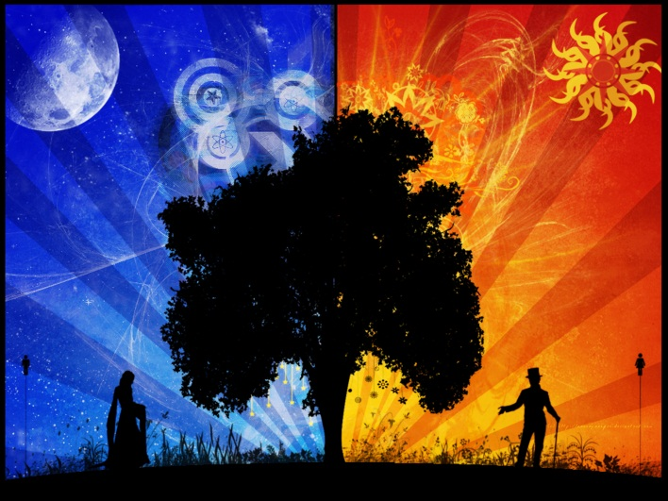
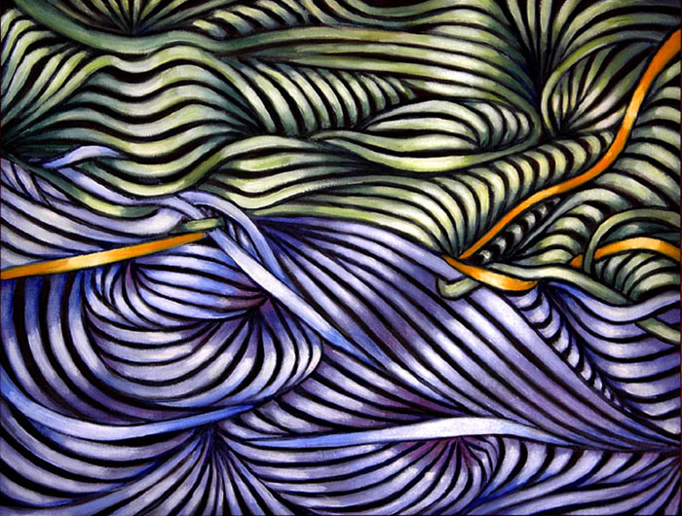
Rhythm continued…
A movement or procedure with a patterned repetition such as a beat in music.
A pattern that repeats an element that has similar form.
How do these art works represent rhythm?
#1
#2
#3
Notes:
(I Do)Concept Development: Everyday examples of rhythm, time, day/night, schedule, music scale.
(We Do)APK & P/S CFU: Think of some examples of rhythm.

Slide 12
5 types of Pattern and Rhythm
Random
Regular
AlTeRnAtInG
Flowing
PROGRESSIVE
Notes:
(I Do) Key Terms←----Key vocab to understanding 5 types of Pattern and Rhythm.

Slide 13
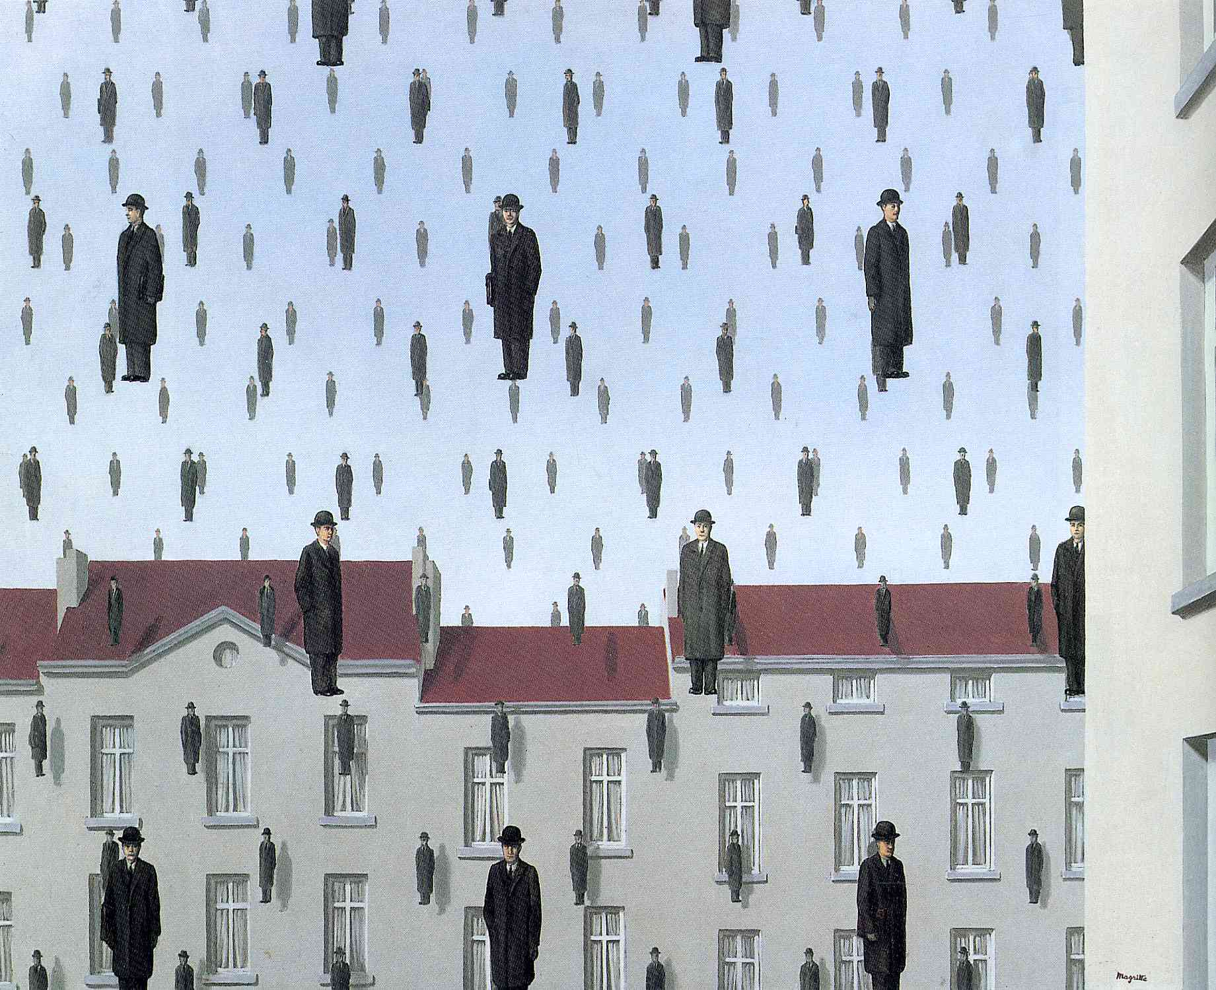
Random Pattern
Has motifs with NO apparent order.
Golconda created by Rene Magritte, 1953 Brussels, Belgium.
Oil on canvas, Surrealism.
Located in Menil Collection, Houston, Texas, USA
Notes:
(I Do)Concept Development: Identifying the Motif and Random pattern.

Slide 14
Regular Pattern & RHYTHM
Has the same motifs that repeat in identical spaces.
Like a heart beat or song with a steady beat, regular rhythms and patterns are created by a series of elements, often identical or similar, that are placed at regular or similar intervals, such as in grids. Simple regular rhythms, if overused, can be monotonous.
Notes:
(I Do)Concept Development: Identifying the Motif and Regular(repeated) pattern.

Slide 15
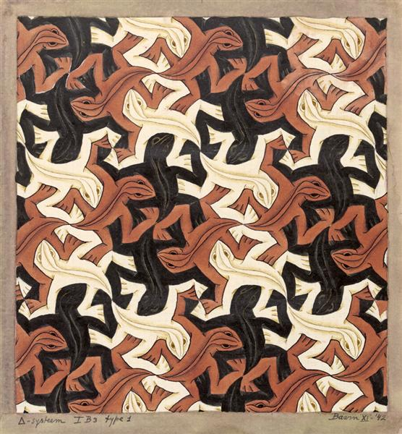
Alternating Pattern
2 or more motifs that repeat regularly.
Lizard created by
M.C. Escher,1942, Op Art.
Tessellation
Two or more different motifs may be alternated, a single motif
might be flipped, mirrored, rotated or the placement or spacing between motifs can be alternated.
This in a way is a regular rhythm that has more complex motifs. The added variety can help lessen the monotony of a regular rhythm.
Notes:
(I Do)Concept Development: Identifying the Motifs and Alternating pattern.

Slide 16
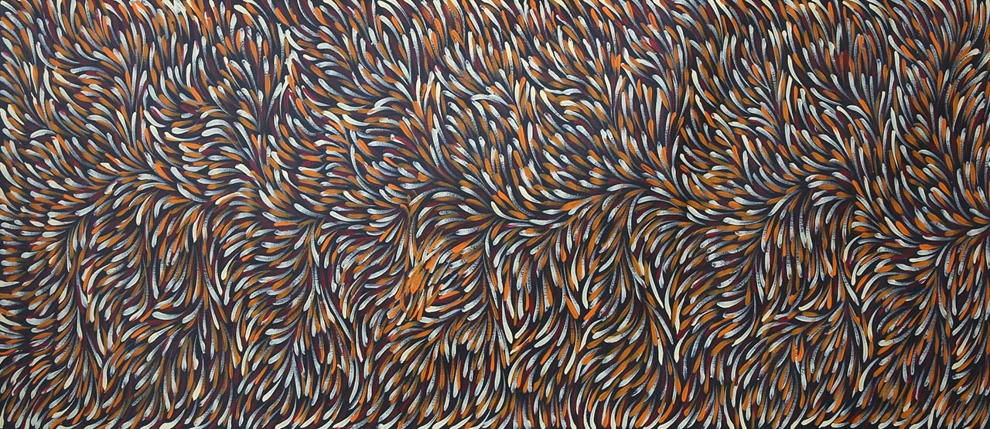
Flowing Rhythm
Repetition of wavy lines.
Bush Medicine Leaves created by Gloria Petyarre, acrylic on linen.
Flowing rhythm is created by bending and curving motifs and spaces.
It can be seen in streams and waterways, sand dunes and glaciers,
hills and wind-blown grasses.
Notes:
(I Do)Concept Development: Identifying the rhythm and the movement. What direction does your eye move? Select student to come up to point at image.

Slide 17
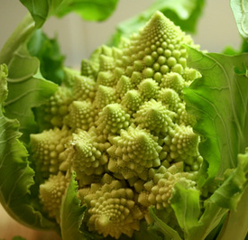
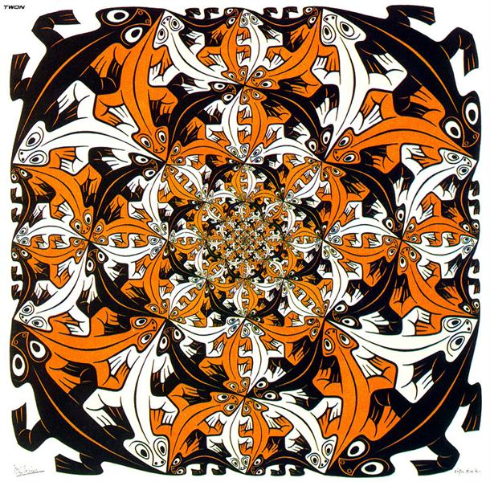
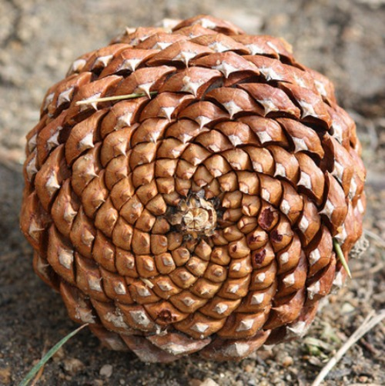
Progressive Pattern & Rhythm
Motifs that change each time they are repeated.
Each time a motif repeats it changes a little, transforming and translating
in a steady sequence - the motif progresses from one thing to another.
Examples from nature:
Romanesco Broccoli
Pine Cone
Smaller and Smaller Color created by M.C. Escher, 1956, Op Art tessellation.
Notes:
Concept Development: Identifying the Motif and Rhythm.

Slide 18
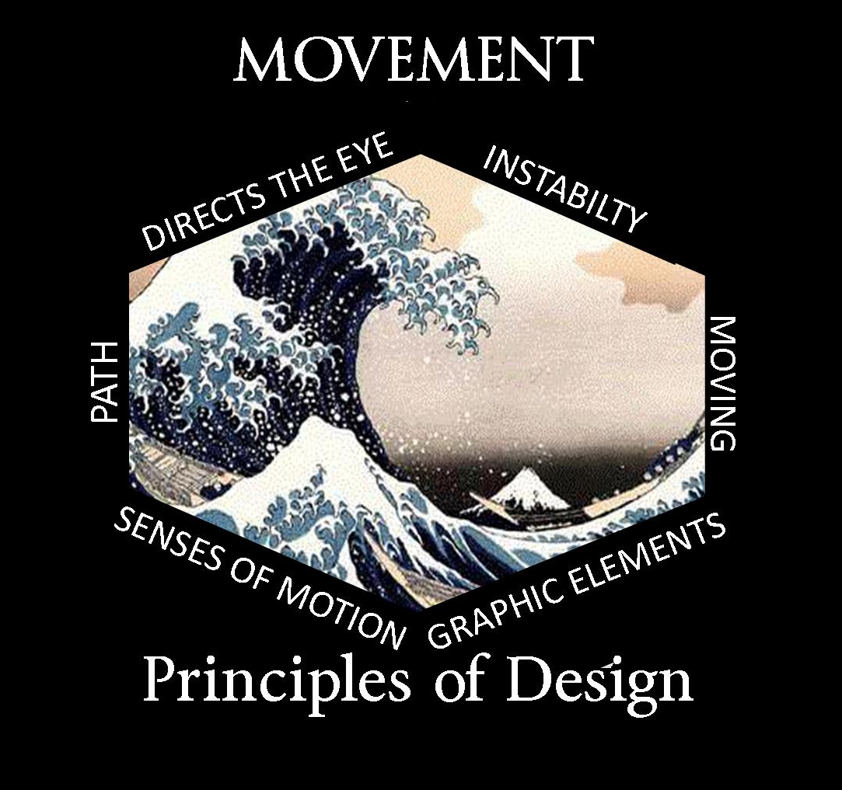
Usage of the art elements to direct a viewer's eye along a path through an artwork, and/or to show movement, action and direction. Some elements are given the ability to be moved or move on their own.

Slide 19
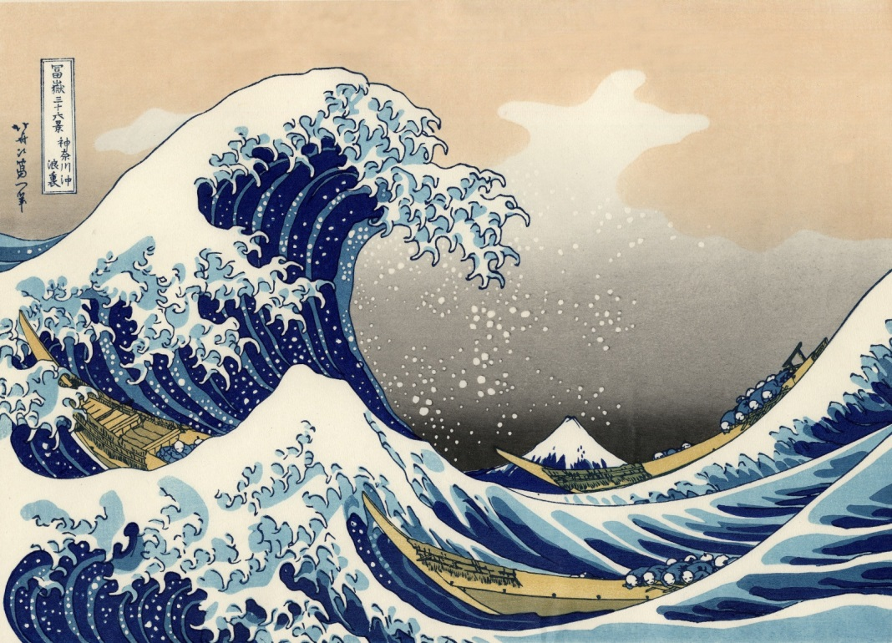
MOVEMENT
Movement is the illusion of motion created by lines, shapes or color that cause the eye to move over the design along those shapes.
Where is the movement in the 2 art works below?
Notes:
(I Do)Concept Development: Underline “movement” and “illusion of motion” and “cause the eye to move”. ←----Key vocab to understanding movement.
People or things may look like they are moving in the artwork, but if there are no people or things, this can also mean how your eye moves through an artwork.
(We Do)APK: We looked at this image once before for Foreground, Middle Ground and Background.
CFU: Which direction does your eye move when you first look at this image? Volunteer to point out?

Slide 20
Pattern, Rhythm, & Movement Review:
To create a pattern in a picture you need to have repetition of a unit or motif.
To create rhythm in the picture you need to have repetition of line, shape, color, or design or a combination of these things. To create movement, the design should have a sense of flow in the picture, a sense of direction.
**A rhythm in the picture can also cause a movement.**
Notes:
(I Do) Review/Concept Development

Slide 21
YOUR TURN!
Notes:
(We,You Do)CFU:P/S
Using White Boards to answer. 1,2,3 hold up your answer.

Slide 22
1.)THE ___________OF DESIGN ARE GUIDELINES TO HELP ARTISTS CREATE ARTWORKS.
Notes:
(We,You Do)CFU:P/S

Slide 23
2.) LIST 3 PRINCIPLES OF DESIGN THAT WERE in the lesson.
Notes:
(We,You Do)CFU:P/S

Slide 24
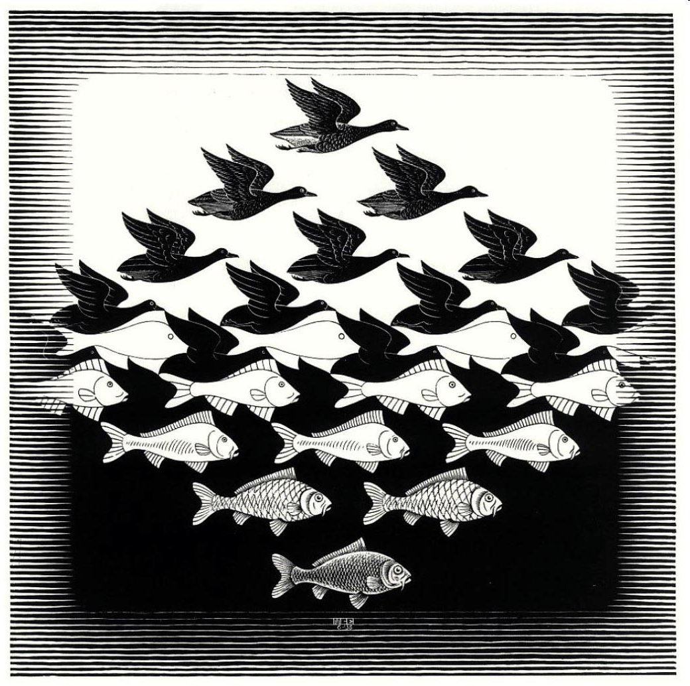
3.) NAME ONE MOTIF IN THIS ARTWORK.
Notes:
(We,You Do)CFU:P/S

Slide 25
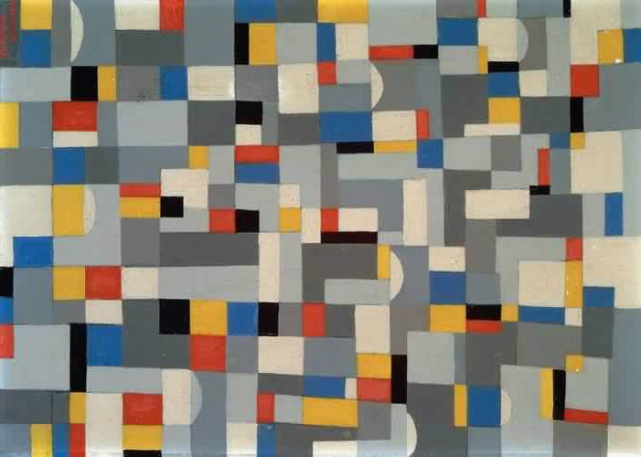
4.)THESE SQUARES AND RECTANGLES HAVE WHAT KIND OF PATTERN? (hint:5 types to choose from)
Notes:
(We,You Do)CFU:P/S

Slide 26
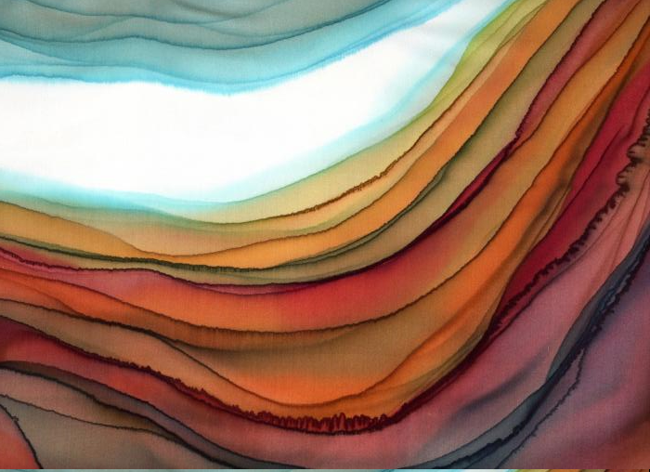
5.)WHAT TYPE OF RHYTHM is IN THIS PAINTING?
Notes:
(We,You Do)CFU:P/S

Slide 27
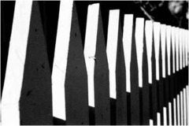
6.)WHAT KIND OF RHYTHM IS SHOWN HERE?
Notes:
(We,You Do)CFU:P/S

Slide 28
7.)WHAT PATTERN ARE THE MOTIFS ARRANGED IN?
Notes:
(We,You Do)CFU:P/S

Slide 29
8.)WHAT TYPE OF PATTERN IS STEWIE’S HEAD ARRANGED IN?
Notes:
(We,You Do)CFU:P/S

Slide 30
9.) Out of the 5 types of Pattern and Rhythm,
draw an example of one.
Random
Regular
AlTeRnAtInG
Flowing
PROGRESSIVE
Notes:
(You Do)CFU/Closure

